Slide 1
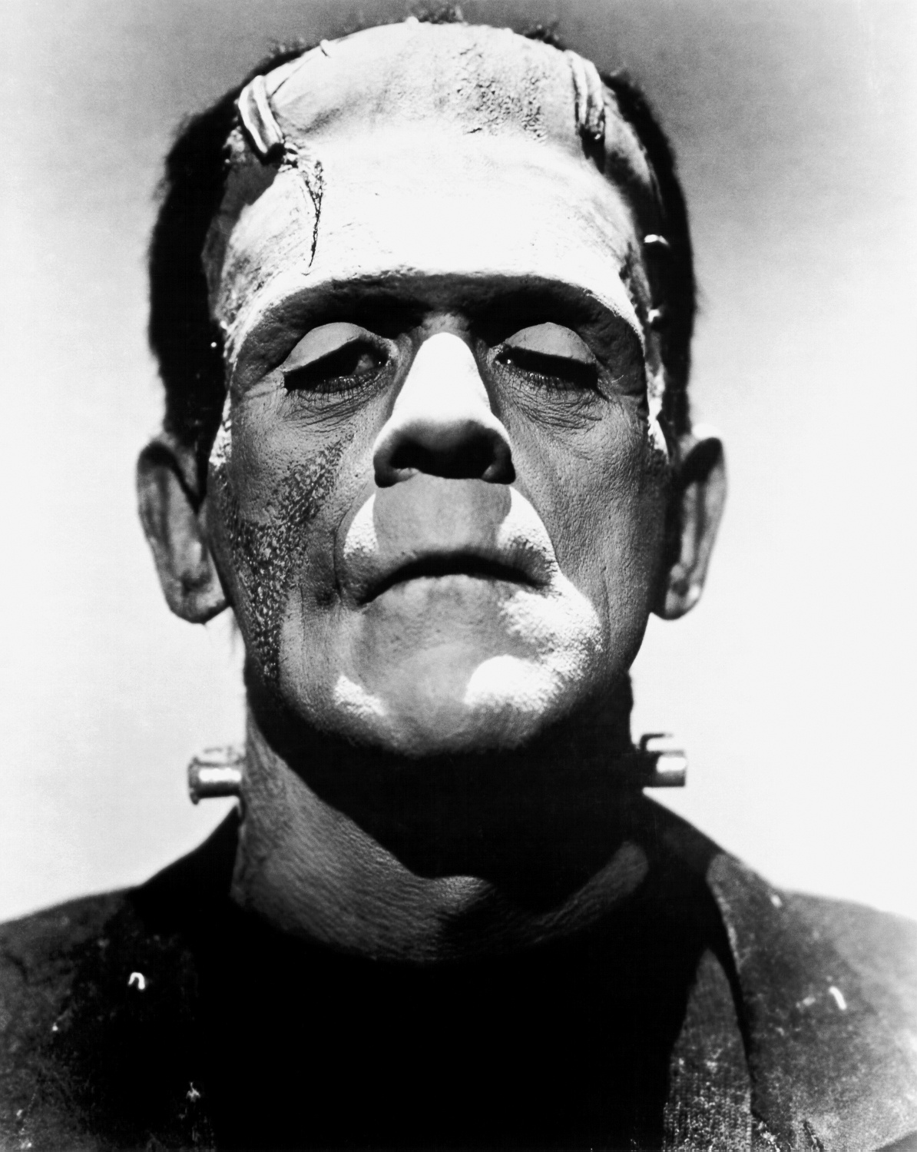
HL8028 – Week 3
Frankenstein
& His Monster(s)

Slide 2
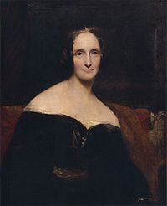
Mary Wollstonecraft Shelley
1797-1851
Daughter of Mary Wollstonecraft (author of A Vindication of the Rights of Woman)
Began Frankenstein at 18
Married poet Percy Bysshe Shelley

Slide 3
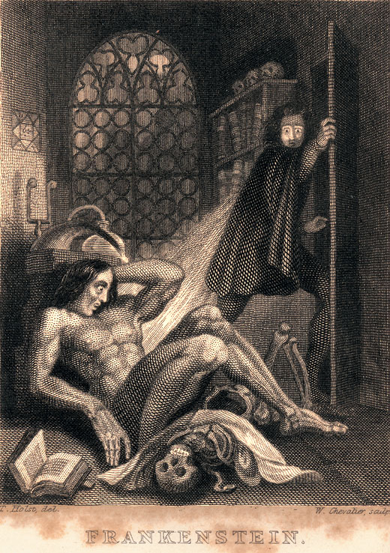
Frankenstein; or, The Modern Prometheus
Published anonymously, 1818
Assumed to be Percy Shelley’s work (or at least written by a man)
Critically well received
Heavily revised in 1831 (more conservative)
Frontispiece for 1831 edition

Slide 4
Signal Question
Pick any one of the “theses” we just reviewed, and explain how you think it is related to Mary Shelley’s Frankenstein (the film). How might the thesis help you interpret the film? Conversely, how might the film help you better understand the thesis?
Write for 5 minutes.

Slide 5
“Monster Culture (Seven Theses)”
The Monster’s Body Is a Cultural Body
The Monster Always Escapes
The Monster is the Harbinger of Category Crisis
The Monster Dwells at the Gates of Difference
The Monster Polices the Borders of the Possible
Fear of the Monster is Really a Kind of Desire
The Monster Stands at the Threshold… of Becoming

Slide 6
How is ‘monstrosity’ created?
William Shakespeare: “Some are born great, some achieve greatness, and some have greatness thrust upon them.”
A modification: “Some are born monsters, some achieve monstrosity, and some have monstrosity thrust upon them.”
Discussion question: Which of these three options best applies to Frankenstein’s monster? Why?

Slide 7
Contexts for the novel
Biographical: the recent death of Shelley’s baby
Political: the French Revolution (1789-99), “Luddite” uprisings in Britain (1811-17)
Scientific: experiments with galvanic electricity in early 19th century

Slide 8
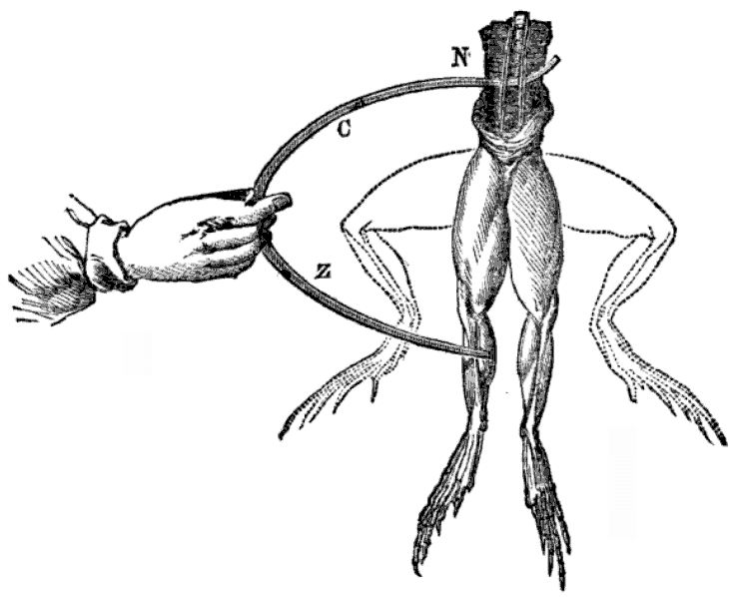
Scientific Background
Public dissections were popular from 14th to 19th century
Galvanism: stimulation of muscles with electricity
Both were practiced on
animals & humans
(including recently
executed criminals)

Slide 9
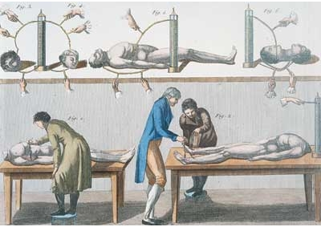
Scientific Background
Dissection often included as ‘additional’ punishment for criminals
Scarcity of corpses induced grave robbing

Slide 10
Parent Problems
“The abundant material in Frankenstein about the abnormal, or monstrous, manifestations of the child-parent tie justifies as much as does its famous monster Mary Shelley’s reference to the novel as ‘my hideous progeny.”
–Ellen Moers, “Female Gothic: The Monster’s Mother”

Slide 11
Parent Problems
“Although Victor is easily read as the father who rejects his ‘son’, ultimately he is not a father, biologically or otherwise. . . . One of the most interesting reasons for the monsters’ lack of name is lack of known ancestry. . . He is removed from the social sphere and positioned in proximity to nature as a wild and uncivilized being. Without a mother, the creatures suffers and becomes monstrous in his actions. Without a father, he is monstrous by virtue of his very being. Without a surname, he simply cannot be identified. This is also a possible reason for his connection to Satan in the novel. His mysterious origins and the inability to place him within the Abrahamic tradition of patrilineage renders him extraneous to Christian narratives of ‘good,’ limiting him to the sphere of the diabolical.”
--Maria Beville, The Unnameable Monster in Literature and Film

Slide 12
Parent Problems
Shelley’s epigraph to Frankenstein:
“Did I request thee, Maker, from my clay
To mould me man? Did I solicit thee
From darkness to promote me?—”
—John Milton, Paradise Lost (1667)

Slide 13
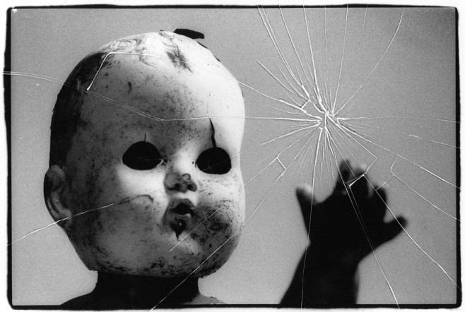
The Uncanny
That which is both familiar and unfamiliar
Produces discomfort, cognitive dissonance
Related to anxiety, apprehension
Ambiguity between animate and inanimate
Examples: dolls, wax figures, automatons, corpses, deja vu

Slide 14
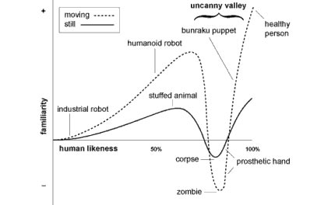
Masahiro Mori, “The Uncanny Valley”

Slide 15
The Freudian “Uncanny”
The uncanny is that which reminds us of our own repressed desires. In the repetition or reoccurrence of that which has been ‘repressed,’ we encounter the strangeness of something that is both familiar and attractive (in the unconscious) and strange and repulsive (in the conscious mind). It mixes attraction and repulsion, familiarity and strangeness. It derives its terror not from something externally alien or unknown but—on the contrary—from something strangely familiar which defeats our efforts to separate ourselves from it.

Slide 16
Adaptations

Slide 17
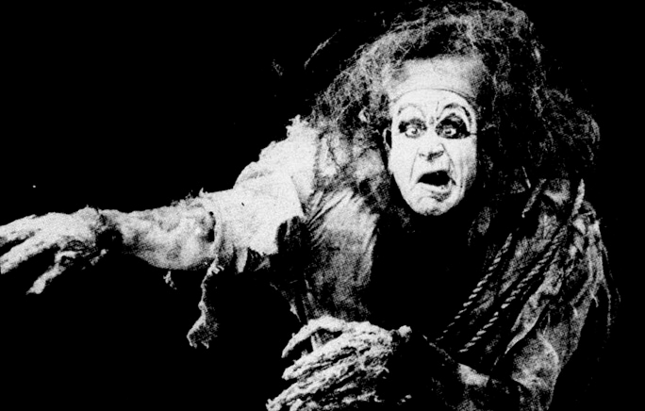
Edison Studios, Frankenstein (1910)

Slide 18
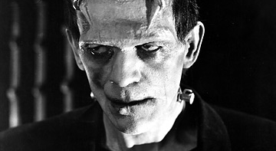
James Whale, Frankenstein (1931): Boris Karloff

Slide 19
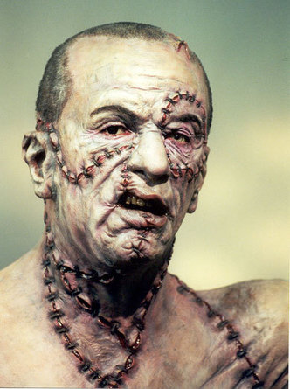
Kenneth Branagh, Mary Shelley’s Frankenstein (1994): Robert DeNiro

Slide 20
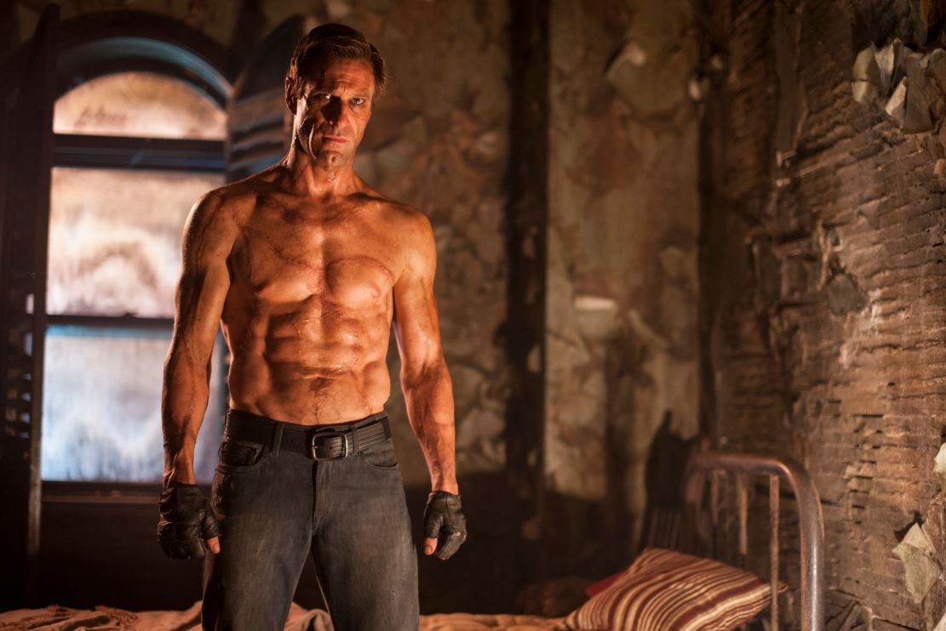
Stuart Beattie, I, Frankenstein (2014): Aaron Eckhart

Slide 21
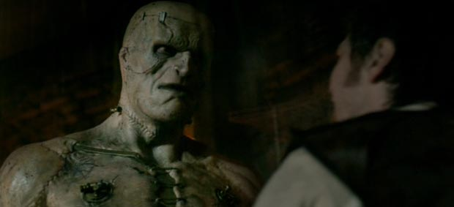
Paul McGuigan, Victor Frankenstein (2015): Guillaume Delaunay

Slide 22
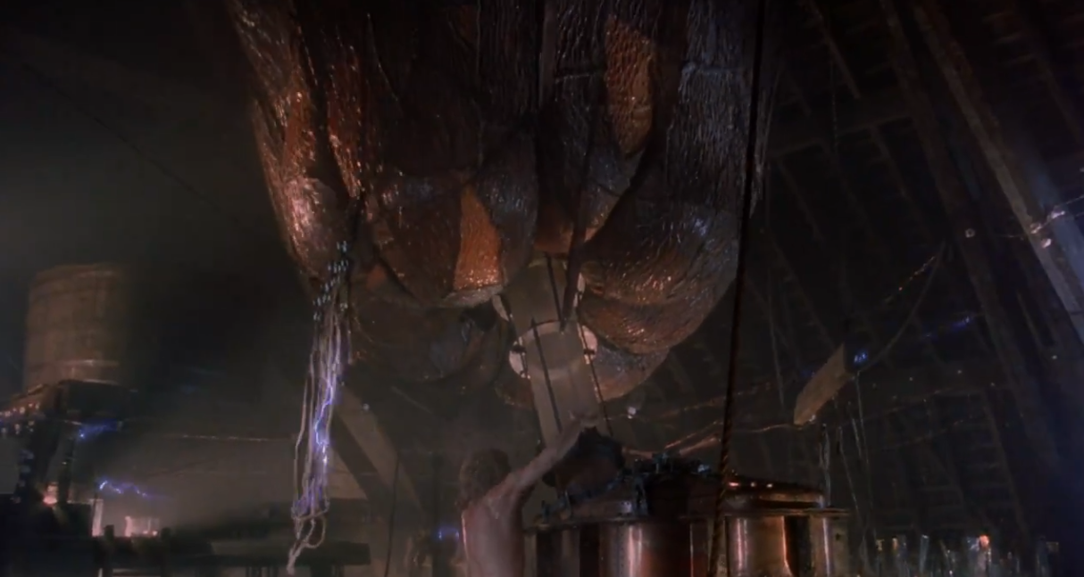
Mary Shelley’s Frankenstein (1994)

Slide 23
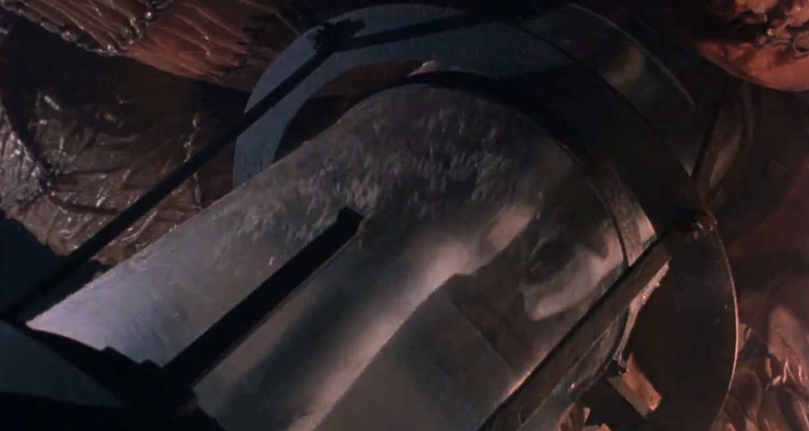
Mary Shelley’s Frankenstein (1994)

Slide 24
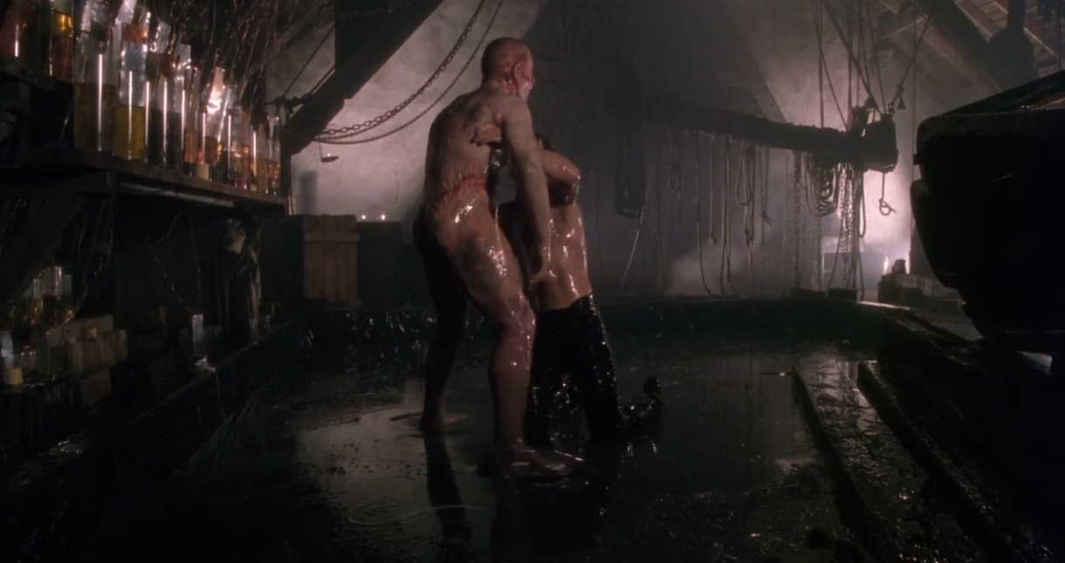
Mary Shelley’s Frankenstein (1994)

Slide 25
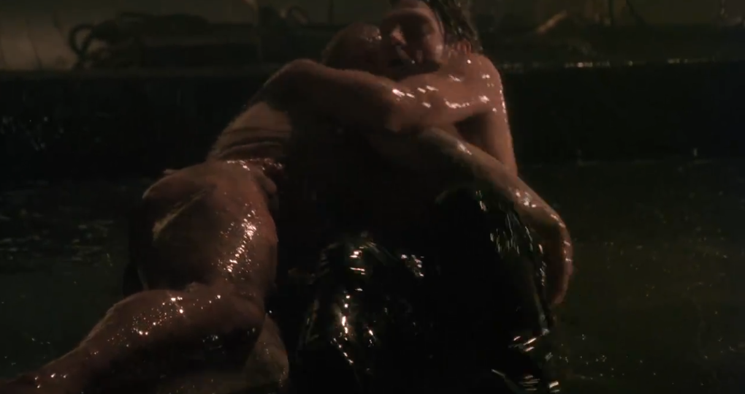
Mary Shelley’s Frankenstein (1994)

Slide 26
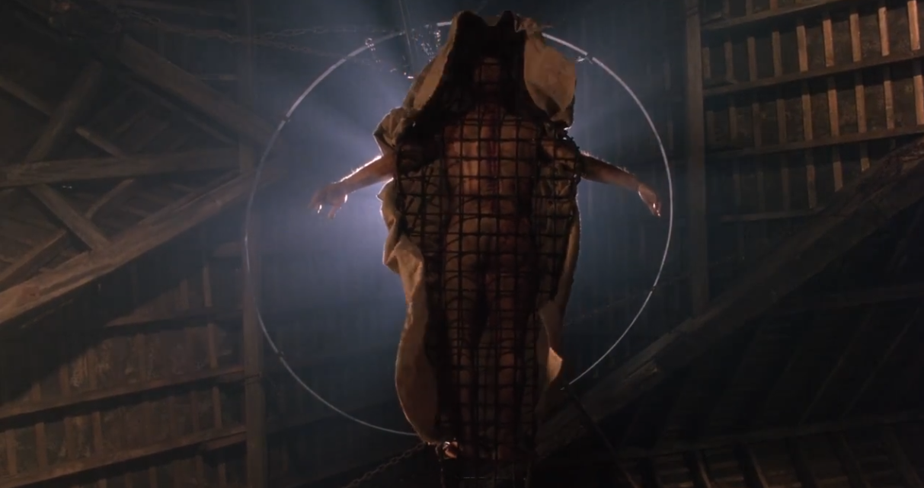
Mary Shelley’s Frankenstein (1994)

Slide 27
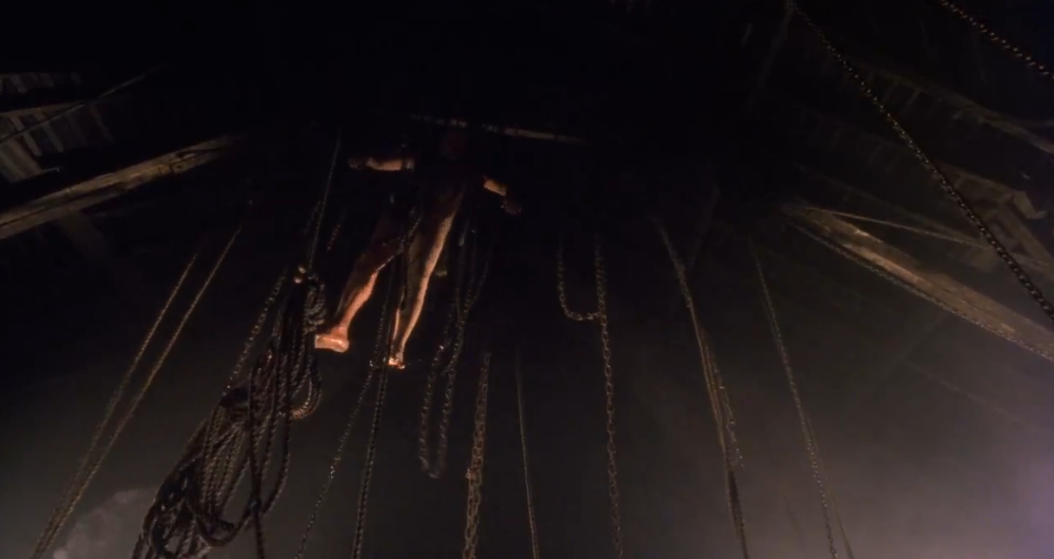
Mary Shelley’s Frankenstein (1994)

Slide 28
Signal Question
Both the novel and the film versions of Frankenstein are concerned with the question of whether the ‘creature’ is human or not. To answer this, we have to decide: “What is the definition of ‘human,’ human-ness, or humanity?”
In what ways, if any, is the creature a ‘monster’?
In what ways, if any, is it human?
What definitions of ‘humanity’ are implied in your answers?

Slide 29
Signal Question
If the creature is a source of both desire/fantasy and anxiety for Victor Frankenstein, what might it represent or symbolize? What are the hidden desires, fantasies, fears, or anxieties evoked in Victor Frankenstein by the creature?

